Slide 1




Contract Design and Conservation Incentives: Experimental Evidence from Burkina Faso
Serge Adjognon and Daan van Soest

Slide 2
1. Introduction
Environmental protection poses a social dilemma
Payments for Ecosystem Servicess
PES increases benefits to private conservation efforts through direct payments
Most PES with individual property rights -Costa Rica (Pfaff et al.2008), Uganda (Jayachandran et al. 2016), Northern Ghana (van Soest et al. 2017)
But most of the forests in sub-Saharan Africa are common property resources which may lead to “Tragedy of the Commons”
Community payments may result in free-riding.
How to adapt contract design to strengthen incentives ?

Slide 3
Challenges of Collective PES
Environmental protection poses a social dilemma
Payments for ecosystem services (Wunder et al. 2005)
Conservation payments conditional on service being delivered by the land owner
Improve (private) cost-benefit ratio of conservation
(Almost) serious money – $20 bln per year:
Part of the “Kyoto process”: REDD+
Also many unilateral initiatives (Sweden, US)
Not without issues/ challenges:
Additionality, leakage (Pattanayak et al. 2010) – “Results are highly divergent”
Still PES indispensible – unconditional payments may even be counterproductive (Wilebore et al. 2017)
What price should be offered?

Slide 4
In theory …
Could threshold-based payments solve social Dilemma in collective encentive scheme?
How?
Obtenir la précision optimale
S’il y a plus de bandes dans une parcelle, la plus fiable est le échantillon

Slide 5
In theory …
Financed by the Climate Investment Funds (CIF)
Supervised by the World Bank (WB) and the African Development Bank (AfDB)
Launched in October 2014
Activities include direct engagement of local communities through:
Sensitization campaigns
Financing of fire blocks constructions
Asset transfers (e.g. Beehives)
Afforestation campaigns using conservation incentives (PES)
This presentation focuses on the PES for tree maintenance

Slide 6
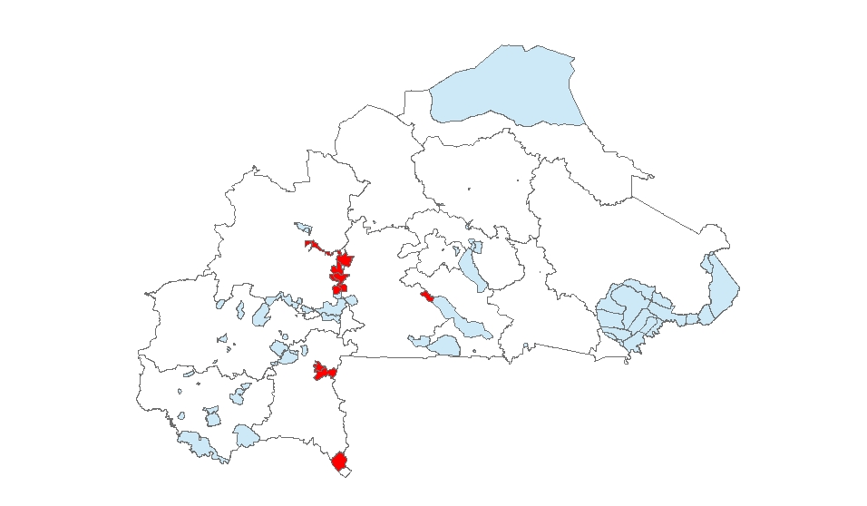
Burkina Faso FIP Forests
Goal of PGFC/REDD+ is to improve carbon sequestration capacity of gazetted forests while reducing poverty in rural areas
The Burkina Faso FIP covers 12 gazetted forests distributed in 31 communes and 4 administrative regions

Slide 7
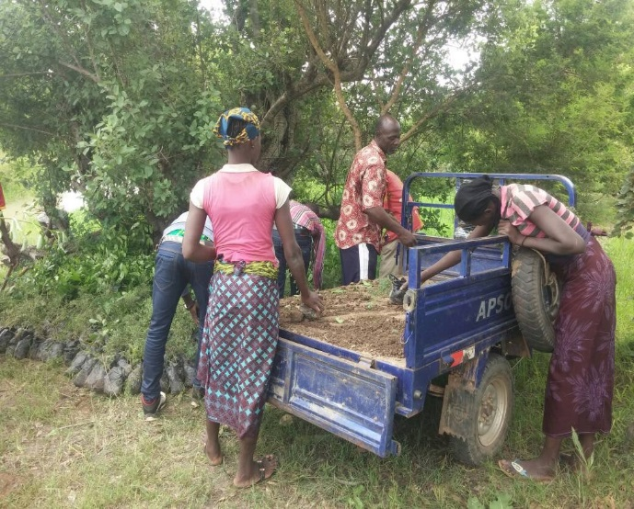
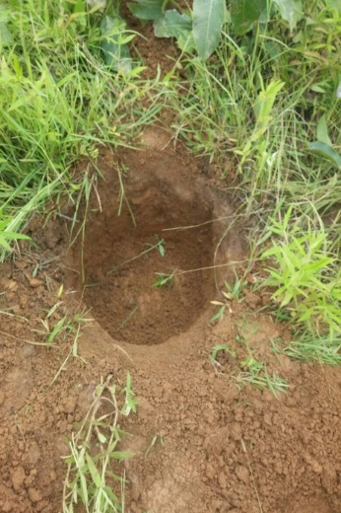
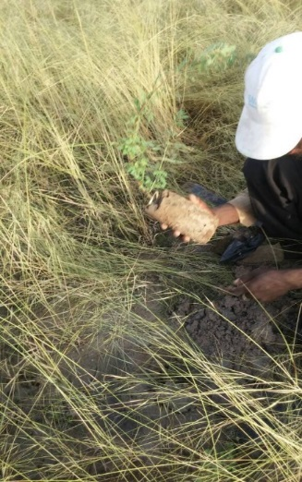
The Burkina Faso Forest Investment Program (FIP)

Slide 8
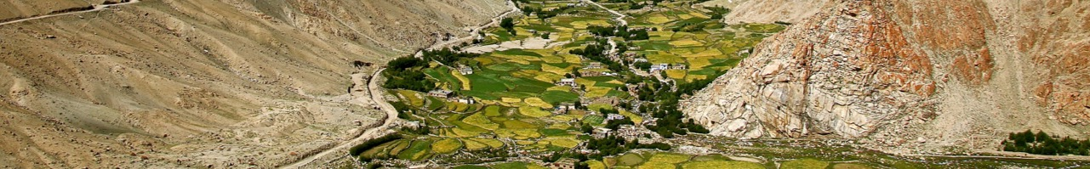
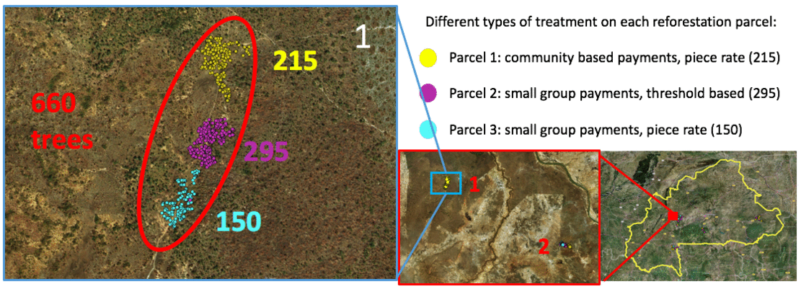
33,547 trees were planted in August 2017

Slide 9
Can Contract design affect Conservation Outcomes ?
Comparing Threshold-based payments versus Linear payments

Slide 10






Can Contract design affect Conservation Outcomes ?
45 000 FCFA
75 000 FCFA
105 000 FCFA
15 000 FCFA
135 000 FCFA
Comparing Threshold-based payments versus Linear payments

Slide 11

Can Contract design affect Conservation Outcomes ?
Comparing Threshold-based payments versus Linear payments
52 500 FCFA
35 000 FCA
17 500 FCFA
0
50
100
150

Slide 12
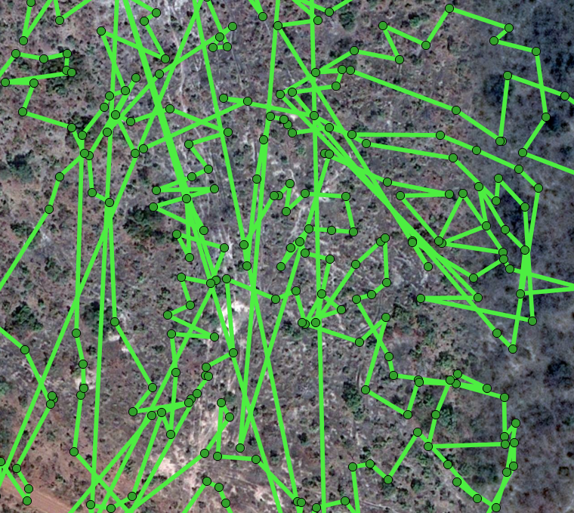
Outcome of interest: Trees Survival Rates
Checking survival rates:
Undoable to find back the trees in the order they were planted last year
Alternative approach?

Slide 13
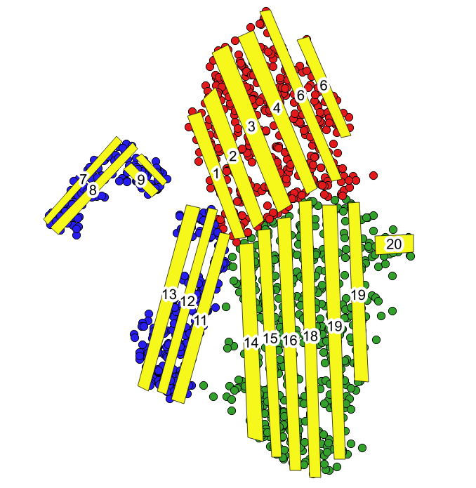
Measuring Survival Rates
Checking survival rates:
Undoable to find back the trees in the order they were planted last year
Alternative approach
Predetermined “corridors” covering substantial share of the land area
Count number of trees still alive…
And compare to number of trees that were planted before
Reliance on ESRI Collector app
Obtenir la précision optimale
S’il y a plus de bandes dans une parcelle, la plus fiable est le échantillon

Slide 14
Survey Data on Participants at Planting
Balance test

Slide 15
Preliminary results: Contract Design Effect
Significantly higher survival rates in linear than in threshold
In terms of trees alive, but even more so in terms of trees with a good chance of survival

Slide 16
Preliminary results
Can we explain survival rates?
(log of) average primary income, share of participants who are GGF member, and the (log of the) average value of livestock (= assets) all play a role
Income vs assets – available time vs wealth?

Slide 17
Preliminary results
Mechanism: bunching just above threshold?
Compare distribution of numbers of trees alive across the treatments
Distribution under threshold just skewed more to the left; not evidence of

Slide 18
Preliminary results: Honesty ?
Overreporting?
Quite substantial in both treatments
Significantly different for threshold, but not for linear

Slide 19
Preliminary results
Bunching near threshold?
Some evidence for this; compare just below 200 to just above, and just below 400 and just above (but not significantly so)
And also not very different from linear

Slide 20
Preliminary results
Farmers neither savvy nor (too) bold in overreporting
13 of 31 farmer groups in threshold did not overreport
Of the 18 that did overreport, 10 benefitted from that – but crossed just one threshold (not more)
Mean amount of “strategic” overreporting is 94 trees (ranging from 36 to 170 trees), but none of these differences resulted in crossing more than one threshold

Slide 21
Conclusion

